Slide 1
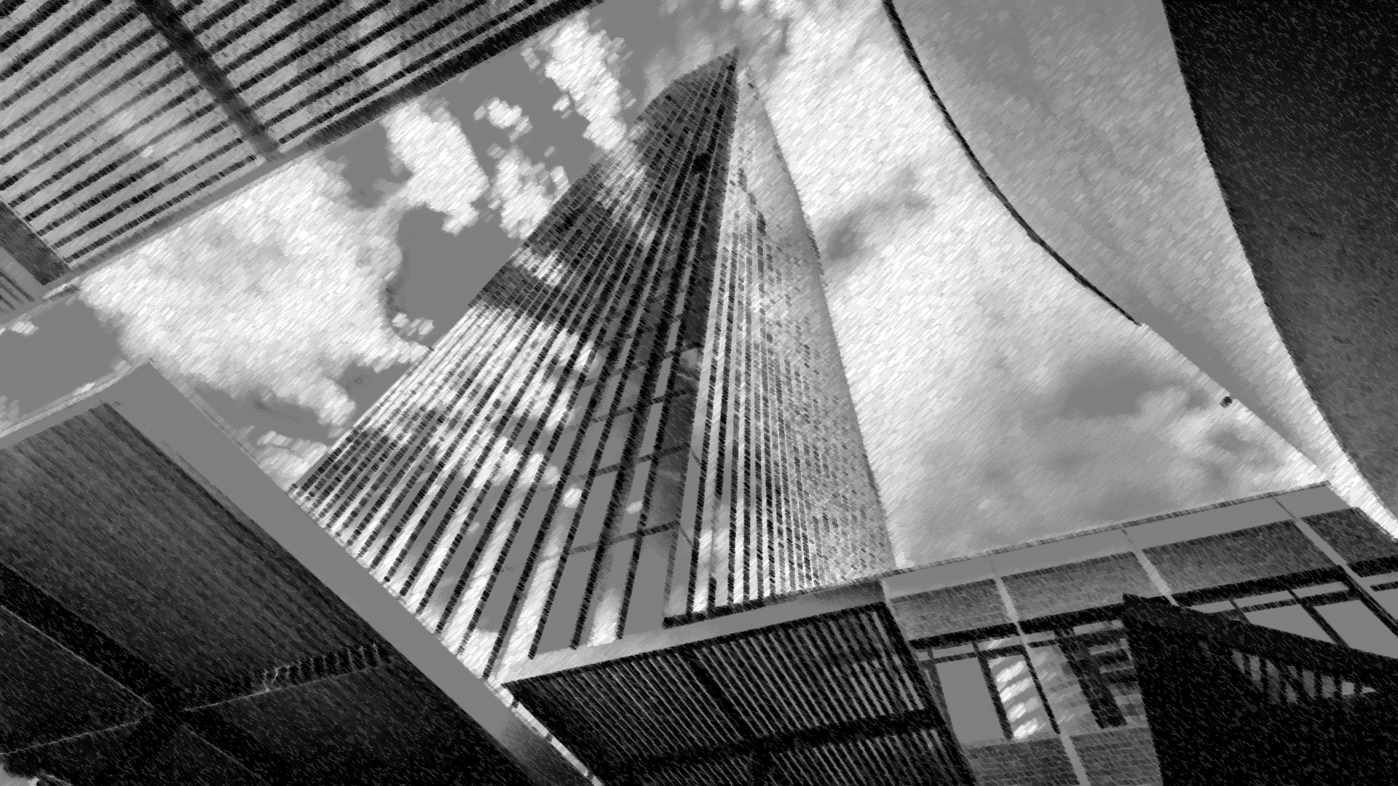
Is Tesla Equity Outperforming the Market for the next 5, 10 and 15 Years?

Slide 2
Data needed:
Growing Industry
Market size, CAGR of EV market (Global and US market),
Yearly sales of EV vs gas vehicle – to show the uptrend of EV sales?
EV sales portion vs New car sales
Diversification Effect:
TSLA revenue breakdown by region, customer breakdown by region (use the map)
Other regional data ?
Social Impact:
CO2, environment, death rate of TSLA
Financial:
TSLA Financials: EBITDA, capex, profitability, risk of the investment
TSLA valuation- comps model
Stock Price Performance and Simulation:
Historical stock price of TSLA and NASDAQ (and probably one main competitor of TSLA) from 2015-2020
Bond yield – US treasury, municipal bonds from 2015-2020
Monte Carlo simulation for the next 5, 10 and 20 years

Slide 3
Market
Costs reduces over time
Core Drivers
Green hydrogen costs to fall by up to 64% by 2040
Source ：Boomberng

Slide 4
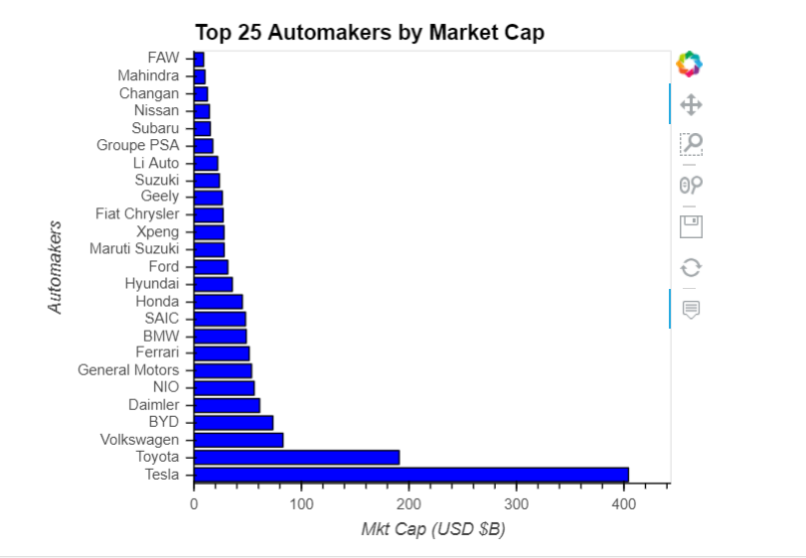
AUTOMAKERS INDUSTRY
Source ：Boomberng

Slide 5
TSLA-Climate & Social Impact
Source ：Factset, Equity Research Report

Slide 6
TSLA-Diversification Effect
Global Operation- Revenue Breakdown by region
Global Operation- Customer Breakdown by region
Source ：Factset, Equity Research Report

Slide 7
TSLA-Financial Analysis
Revenue
Capex
Profitability
Some othe metric
Valuation Highlights - Comps model
7
Source ：Factset, Equity Research Report, FS. Note 1, adjusted EBITDA = EBITDA excludes share based payments

Slide 8
Tesla CEO,Elon Musk disclosed that the automaker was “about a month” away from bankruptcy just as the Model 3 sedan was readying for mass production.
Elon Musk said that the period between mid-2017 and mid-2019 when the Model 3 ramp commenced was “extreme stress [and] pain for a long time.” Musk described the time period as “production [and] logistics hell. I put in my last money, even though I thought we would still fail. But, it was either that or certain death for Tesla,”
Musk said it was “extremely difficult to raise money for an electric car startup” at a time when competitors like General Motors and Fiat Chrysler, were going bankrupt.
Souce: www.benzinga.com/news
Source ：Factset, Equity Research Report

Slide 9
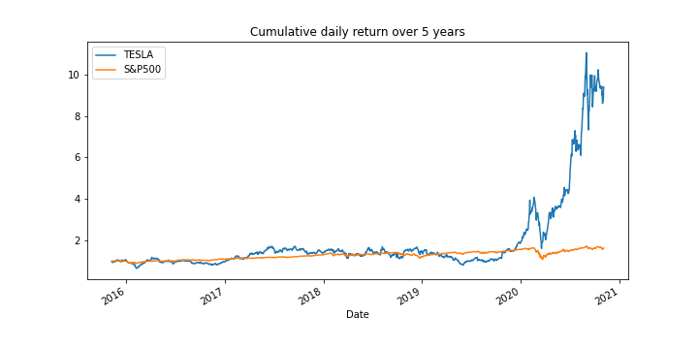
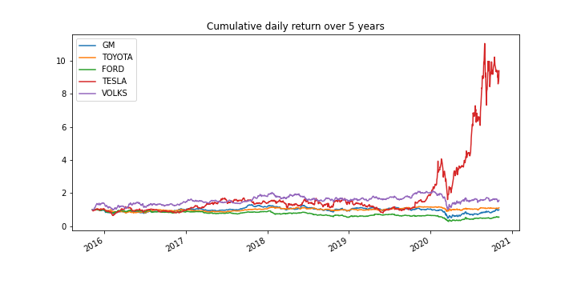
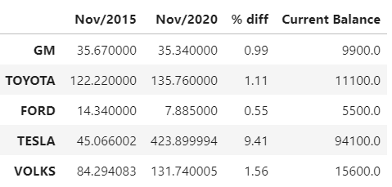
TSLA-Historical price Analysis for the last 5 years
TSLA vs S&P500
TSLA vs main competitor
Stock price
If you have invested $10.000 over 5 years in TESLA stock your balance would be $94.100
Source ：Alpaca trade API / Yahoo Finance

Slide 10
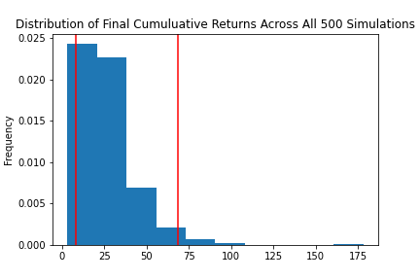
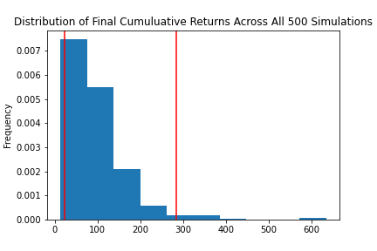
TSLA-Sensitivity Analysis for next 20 years
Monte Carlo Simulation Portfolio Without Tesla
Monte Carlo Simulation Portfolio With Tesla
With an initial investment of $10.000 in your portfolio you have a 95% chance it will be within the range of $82.972.21 and $683.666.61 over the next 20 years
With an initial investment of $10.000 in your portfolio you have a 95% chance it will be within in the range of $226.781.95 and $2.835.449.51 over the next 20 years
Portfolio = Apple Inc. , Alphabet Inc. , Johnson & Johnson , Berkshire Hathaway Inc.
Source ：Alpaca trade API / Yahoo Finance

Slide 11
Investment Theses - Strong Business Model Drives Potential
Investment Advice
Investment Theses
Investment Risks
Risk analysis
 | High |  | Capital Requirement | Profit Generation Timeline
Impact | Medium
 | Low | Foreign Exchange Risk | Geographical Concentration
 |  | Low | Medium | High
 |  |  | Likelihood
Source：Factset, Equity Research Report
Notes:
Financial – vs corp, bond, index for 5, 10, 15 years
comps
Social impact – global impact investment, local community -> diversification
Climate

